Slide 1
Visual Question Answering Increment#1
Team Members:
Avni Mehta
Santosh Yadav Jada
Harshil Lavjibhai Patel
Trinadha Rajeswari Muppala

Slide 2
Objective
Dataset
To implement the visual question answering system that would answer open ended free-form questions of natural language like English.
The model will be trained on thousands of images in order to extract the important features of these images using CNN and LSTM networks.
The most famous dataset for VQA is MS COCO dataset.
Owing to lack of hardware resources, we will use a small subset of the dataset.
Domain selected : Interiors

Slide 3
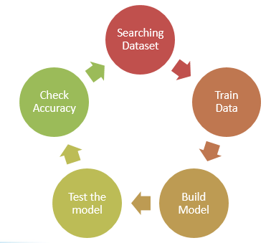
Workflow

Slide 4
Accomplishments so far..
Dataset domain selection.
Image classification using Decision Tree, Random Forest, Naïve Bayes
Analysis of various metrics for above models
Video summarization using Clarifai API.

Slide 5
Next steps..
Preprocessing data if required.
Image Classification using deep learning models (CNN, LSTM).
Test already available model. Change the parameters, models and try to get better accuracy.
Development of an interactive user interface.

Slide 6
Challenges
Hardware: Small dataset might be used owing to lack of hardware configuration.
Accuracy: By using small dataset, we will face poor accuracy issue.

